Slide 1
Systems Engineering Seminar:
Getting the Most From Simple Models
Conrad Schiff
4/9/13

Slide 2
Preliminary Quotations
The miracle of the appropriateness of the language of mathematics for the formulation of the laws of physics is a wonderful gift which we neither understand nor deserve. Eugene Wigner
Our life is frittered away by detail. Simplify, simplify, simplify! Henry David Thoreau
Everything should be made as simple as possible, but not simpler. Albert Einstein
There is usually a simple explanation but it may be very hard to find it! Lewis Carroll Epstein

Slide 3
Context
The preliminary quotations form the basis for my philosophy for solving technical problems within the systems level requirements context
  Simple models work, start with them
  Add complexity, only as needed
  Know the answer before you run a big simulation on a computer
  You really don’t know anything until you can explain it (review test)
Three case studies (of many) demonstrate the application
  Magnetospheric MultiScale Mission (MMS) launch window
  Wilkinson Microwave Anisotropy Probe (WMAP) science orbit selection
  James Webb Space Telescope (JWST) Contact times
Please feel free to interrupt

Slide 4
Magnetospheric Multiscale (MMS)

Slide 5
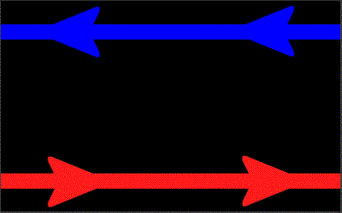
Magnetic Reconnection
Magnetic reconnection is a fundamental process in plasma physics (terrestrial and space)
It converts magnetic energy into kinetic energy
  Oppositely directed parallel field lines are pinched
  They cross, mix, and then snap apart like a breaking rubber band
Benefit: understanding of how the Earth lives with the Sun (e.g. Class X Flash 0156 GMT Tuesday, Feb. 15, 2011)‏
  Power grid problems
  Communications disruption
  Aurora formation
Credit: European Space Agency

Slide 6
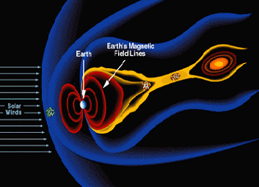
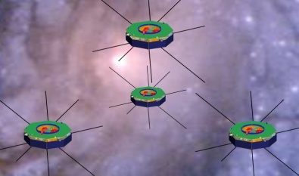
MMS Mission Overview
Earth Magnetic
Field Lines
Earth
Orbits
Elliptical Earth orbits in 2 phases
Phase 1 day side of magnetic field 1.2 R_{E} by 12 R_{E}
  10km tetrahedron spacing
Phase 2 night side of magnetic field 1.2 R_{E} by 25 R_{E}
  _{30km tetrahedron spacing}
Significant orbit adjust and formation maintenance
Instruments
Identical in situ instruments on each satellite measure
Electric and magnetic fields
Fast plasma
Energetic particles
Hot plasma composition
Observatory
Spin stabilized at 3 RPM
Magnetically and Electrostatically Clean
Launch Vehicle
Launched as a stack aboard an Atlas 421 with
Centaur upper stage
Earth
Solar
Wind
Science Objectives
Discover the fundamental plasma physics process of reconnection in the Earth’s magnetosphere
Temporal scales of milliseconds to seconds
Spatial scales of 10s to 100s of km
Mission Description
4 identical satellites
Formation flying in a tetrahedron
2 year operational mission (plus 120 day commissioning)

Slide 7
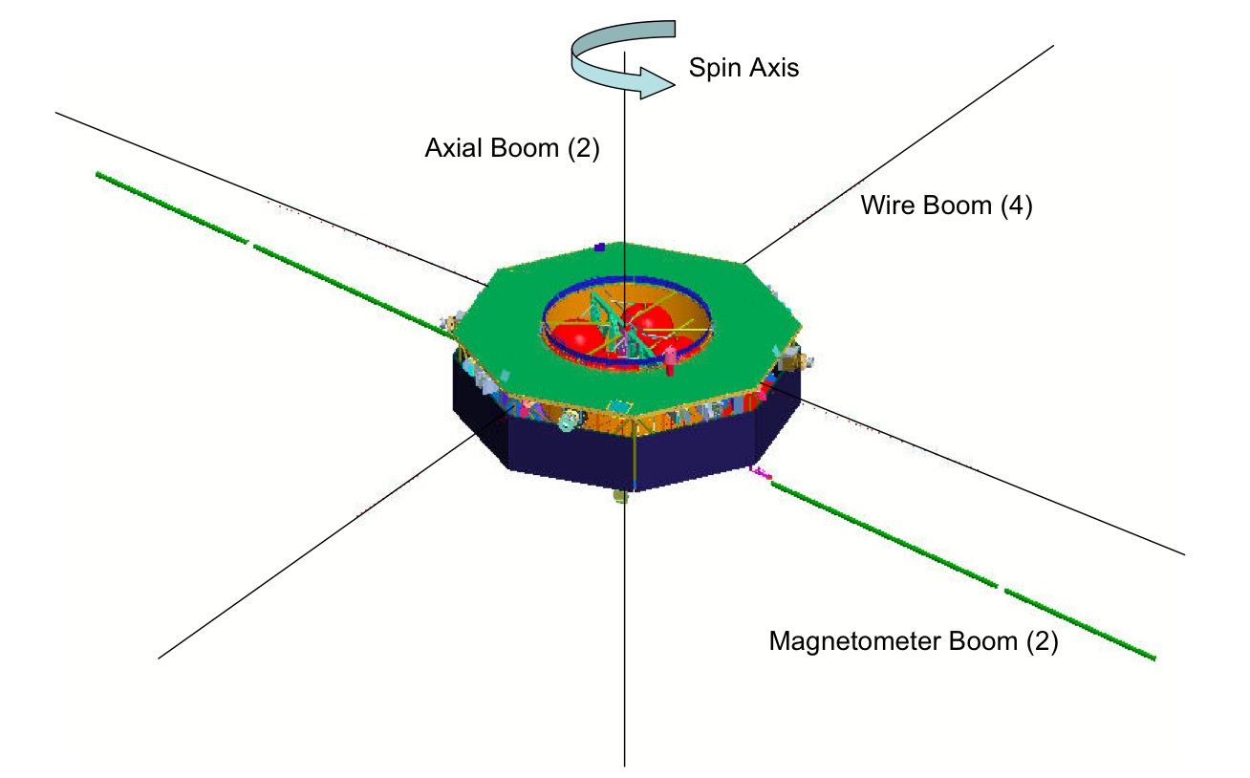
MMS Spacecraft Fully
Deployed Configuration
(Not to Scale)
Full complement of ‘particles and fields’ instruments. Particles on spacecraft body. Fields on booms.
Spin axis – within 2.5 deg of ecliptic north
Spin rate – 3 +/- 0.2 rpm
Boom Lengths
  Mag boom: 5 m
  Axial boom: ≈ 12.5 m
  Wire boom 60 m
Spacecraft Dimensions
  Diameter: ≈ 3.4 m
  Height: ≈ 1.2 m
Onboard controller tasked with performing all spin-attitude (and most delta-V) maneuvers

Slide 8




MMS Flight Dynamics Concept
Use the formation as a ‘science instrument’ to study the magnetosphere
Magnetic field lines
Night-side science (neutral sheet) bound by power (limits shadow duration)
Need to prevent close approaches (<4 km)
30-400 km
10-160 km
Maneuvers used to maintain formation against relative drift
Sun
Formation scale matches science scale

Slide 9







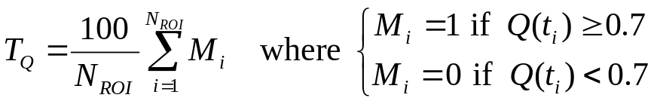
Formation Flying
Target formation has shape of a regular tetrahedron in the science region-of-interest (ROI) (TA ~160-200 deg)
Goodness of the formation is expressed in terms of a quality factor Q(t) ⊃ [0,1] which is a product of two terms
  Q_{s}(t) associated with scale size (allows for ‘breathing’)
  Q_{v}(t) measures how close the shape is to a regular tetrahedron
Science requirement is expressed by T_{Q}, the time the formation spends in the ROI with a Q(t) above 0.7
  T_{Q} ⊃ [0,100]
  Current science goal to have T_{Q} > 80 for each orbit
2
3
1
4
shape
volume

Slide 10
Visual Summary of the Required Baseline
Phase 0
06:00
Perigee Raise
1.04 Re → 1.2±0.1 Re
Phase 1a
GSE Latitude
[-20º, 20º]
when
Apogee GSE
time
[14:00-10:00]
Phase 1x
06:00
06:00
No formation
science
~02:00
12:00
00:00
12:00
00:00
12:00
Allowed
Phase 1a
start range
120-day commissioning
17:00
19:00
19:00
18:00
17:00
No shadow > 1 hrs
during first 2 weeks after launch
18:00
18:00
No formation
science
Phase 2b
06:00
Phase 2a
Phase 1b
06:00
GSE Latitude
[-25º, 25º]
when
Apogee GSE
time
[14:00-10:00]
Neutral Sheet Dwell
Time >= 100 hrs
10:00
10:00
12:00
00:00
-10 Re
12:00
00:00
12:00
-10 Re
Apogee Raise
12 Re → 25 Re
18:00
No formation
science
18:00
18:00

Slide 11
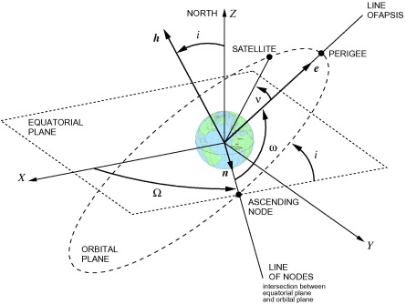
How to Achieve the Desired Science
Need to turn the geometry on the previous slide into actual inertial targets for the launch vehicle (Atlas)
The primary two targets of the injection orbit are:
  Right-Ascension of the Ascending Node
  Argument of Perigee

Slide 12
Old Verification Process
Notional
Design
Definitions &
Requirements
Parameters
Spacecraft
Ground System
ELV
Launch Date
& Time
Reference Orbit
Generation
Candidate
Ephemeris
Preliminary
Verification
DVs
Launch Window
Ephemeris
Navigation
Monte Carlo
Navigation
Covariances
Orbit Determination
Performance
End-to-End
Simulation
Nominal
Monte Carlo
Cases
Formal Verification
by Analysis

Slide 13
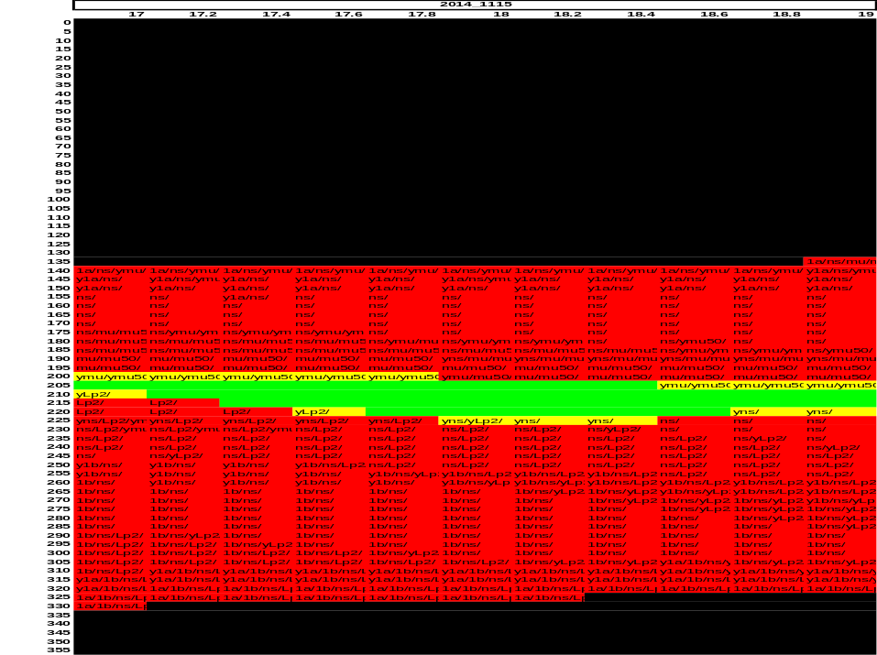
Reference Orbit Generation
Sample reference orbit output for one launch day
Six baseline orbit metrics used to classify cases
Reference orbit (limited modeling) used to find candidate launch opportunities
End-to-end (ETE) code used for verification
  Nominal case (without knowledge and execution errors) gives baseline
  Monte Carlo (with errors) for formal verification
AOP
Took hours to generate
RAAN
Metric | Requirement | Reference orbit value | ETE orbit value
Phase 1a GSE Latitude, λa (deg) | 0 < |λa| ≤ 20 | [1.41,3.85] | [3.16,5.28]
Phase 1b GSE Latitude, λb (deg) | 0 < |λb| ≤ 25 | [-5.94,-1.91] | [-4.56,-0.73]
Neutral sheet dwell time, TNS (hours) | TNS ≥ 100 | 232.06 | 287.38
Maximum umbra duration, MU (minutes) | MU ≤ 216 | 174.27 | 189.90
Maximum umbra + 50% penumbra, MUP (minutes) | MUP ≤ 231 | 183.23 | 200.70
Max. shadow in the first 2 weeks, MS (minutes) | MS ≤ 60 | 0 | 0

Slide 14
Analytic Model: A Better Way
The Reference Orbit Generation was a bottle neck
  used a numerical integration scheme to map out the trade space
  took hours of computing time to investigate one day
  changes in requirements required extensive code re-writes
Switched from numerical models to analytic models based on the Gauss Planetary Equations (sometimes called Gauss VOP)
  one-orbit averaged orbital elements ‘propagated’ using the equations of motion
  J2 term only used from the geopotential
  luni-solar gravity included in an coarse way
Add MMS mission constraints in a mix-and-match way to determine which ones were drivers

Slide 15
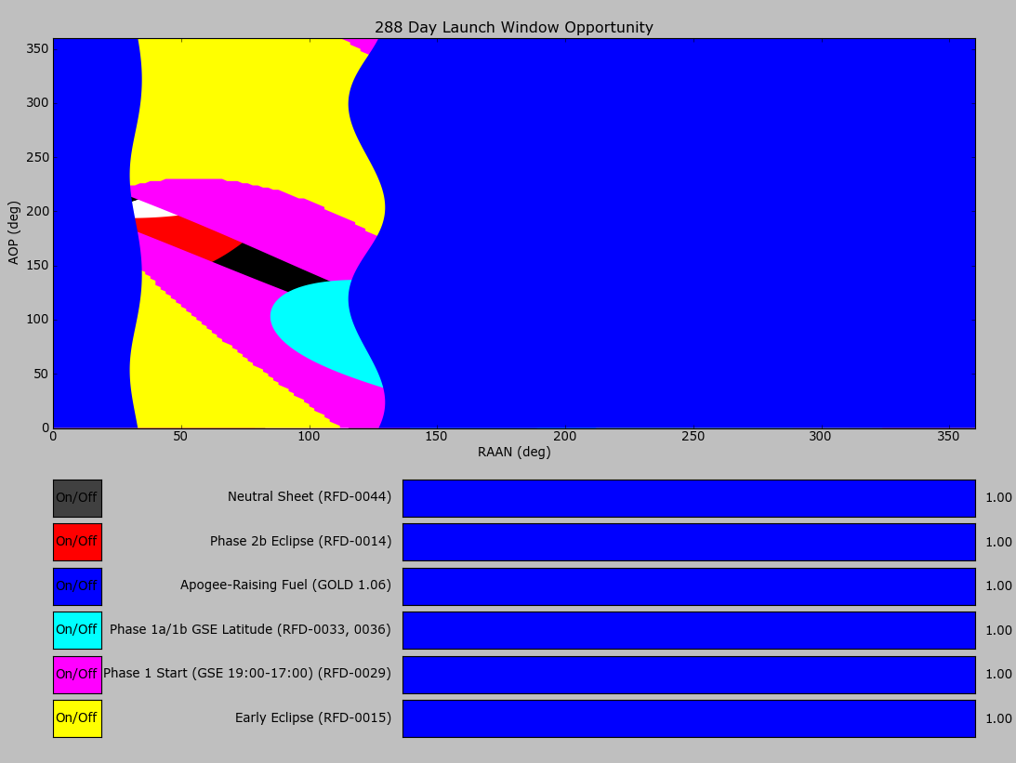
Analytic Model in Action
(SWM76 created by Trevor Williams)
Oct 15th Launch Case
Output shows allowed/forbidden regions in the RAAN-AOP parameter space by requirement or constraint.
Candidate launch opportunities are identified by the unfilled regions
Candidates are used to guide high-fidelity simulations which, in turn, verify the analytic predictions
Within minutes a year’s worth of launch cases can be examined
Allowed region ‘width’ is an estimate of the length of the daily launch window
(ω_{e} ~15 deg/hour)

Slide 16
Wilkinson Microwave Anisotropy Probe (WMAP)

Slide 17
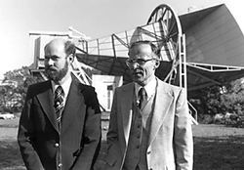
The Discovery of the Cosmic Microwave Background (CMB)
Found by Penzias and Wilson in 1963
Essentially a‘noise’ signal from all directions
  Peaked in the microwave band
  Thermal blackbody radiation at roughly 2.7 K
Interpreted by Peebles to be the red-shifted remnant radiation from the big-bang
Netted Penzias and Wilson the Nobel prize in Physics in 1978
Penzias and Wilson

Slide 18
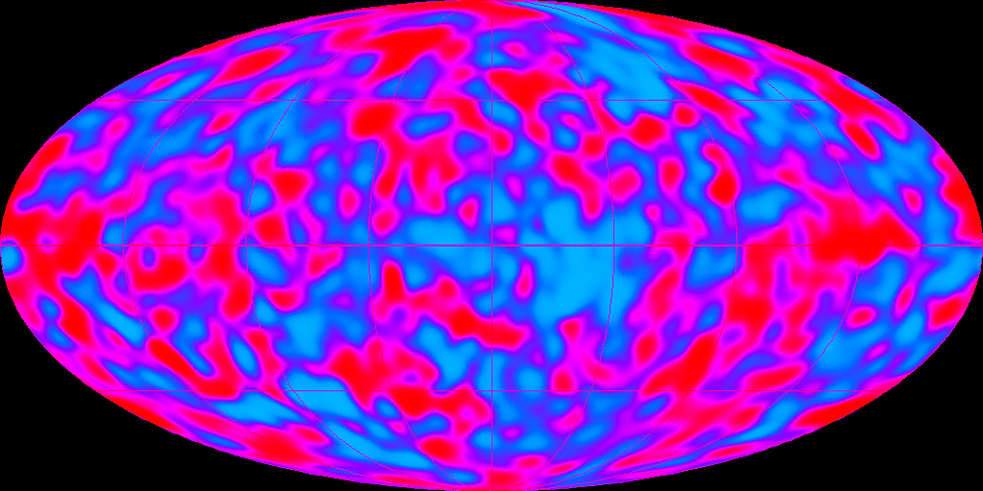
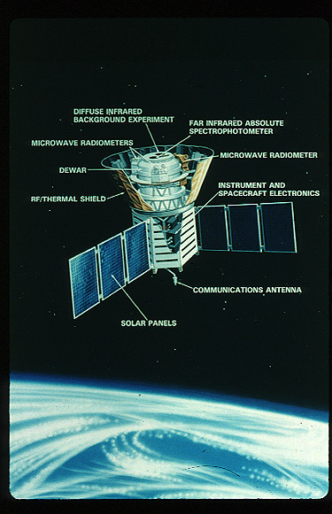
Is it Smooth?
COBE Launched in Oct. 1989
Found fluctuations in the CMB radiation
Quantum field theory coupling to General Relativity
Netted George Smoot and John Mather the Nobel prize in Physics in 2006
According to the Nobel Prize committee, "the COBE-project can also be regarded as the starting point for cosmology as a precision science"

Slide 19
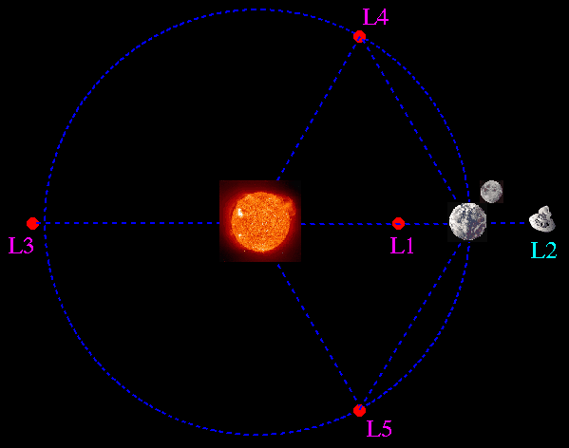
The Lagrange Points: Ideal CMB Vantage Points
COBE success prompted follow-on missions to study the CMB with greater precision
  WMAP
  Planck
In order to probe the CMB anisotropy the detectors had to be a lot cooler
The Sun-Earth/Moon L2 Lagrange point makes an ideal station
  All the hot objects are one side
  Passive cooling can achieve temperatures around 40-60 K
Key question: How to get there?
(earth-sun system)

Slide 20
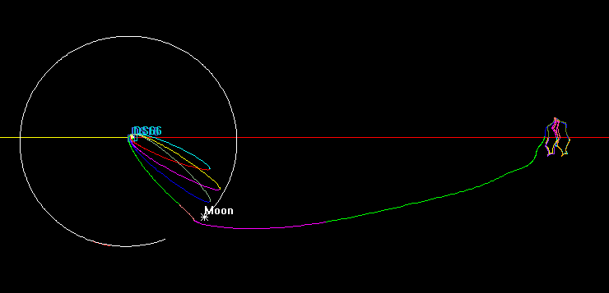
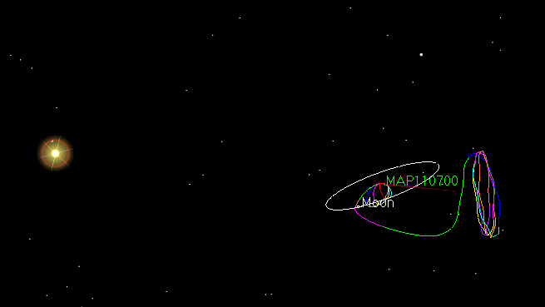
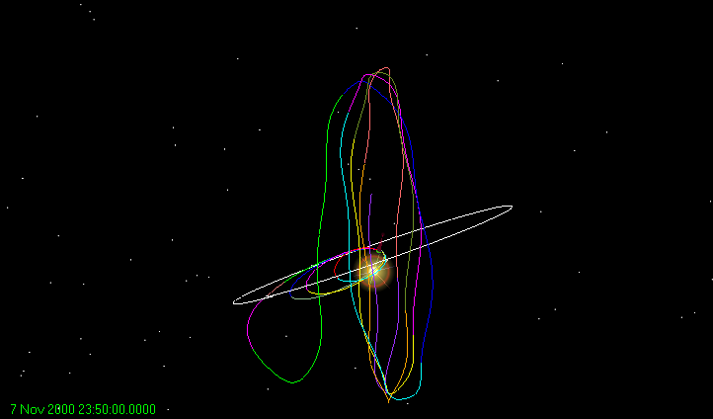
Sample MAP Trajectory
Essential Mission Requirements
(‘Thermal Shock’)
Avoid earth shadows at L2
Avoid lunar shadows at L2
Rotating Libration Point (RLP)coordinate system: Sun-earth-moon system

Slide 21
Design Issues Crop Up
In late summer of 1999, I was commissioned by GSFC to verify the mission design being done by the team at CSC
Particular focus was on the problems they were having finding trajectories that avoided lunar shadows at L2
The team at CSC was well-experienced
  I had been a member of that team for a number of years
  Many of us flew ACE to the Sun-Earth/Moon L1 point only 2-3 years earlier
I went back to the simple approach mentioned earlier and I asked myself if I could prove that the requirement was impossible to achieve
  Start with the Circular Restricted Three Body Problem (Sun & Earth/Moon)
  Find the motion at L2 by linearization -> Lissajous solution
  Feed that analytic solution into the mission design tool called FreeFlyer to find the global structure of lunar shadows as a function of the Lissajous parameters

Slide 22
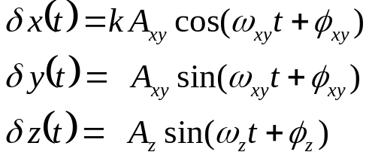
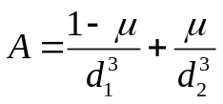


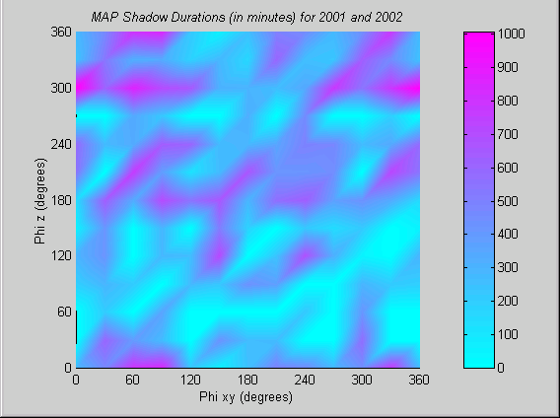
Scuttling a Requirement
Linearized CRTBP EOMs
Lissajous motion around L2
Phase diagram shows only limited regions lunar shadow free
Regions ‘unstable’ to normal changes in mission – including launch date & time, and changes in transfer trajectory
Conclusion: Requirement is impossible to design out

Slide 23
James Webb Space Telescope (JWST)

Slide 24
Heading to L2 (Again)
Like WMAP and Planck, JWST finds advantages in being at the L2 point
  Enables passive cooling of the Infrared telescope
  All the ‘hot’ objects are hidden from view behind a sun-shield
Basic question: how to manage science downlink?
Derived question: how much visibility from the DSN?

Slide 25
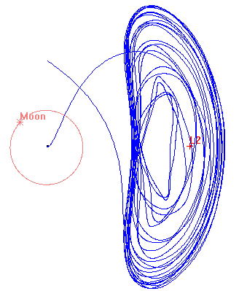
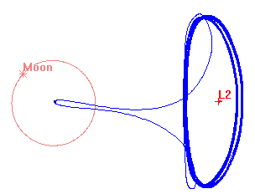
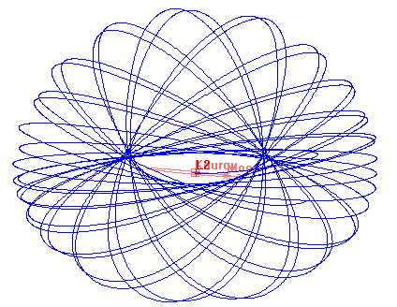
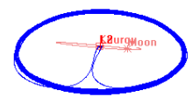
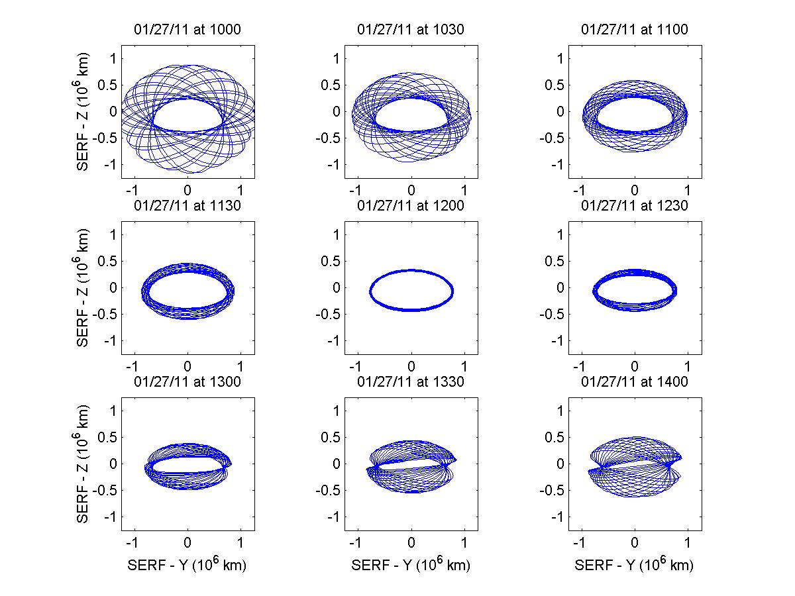
Menagerie of Libration Point Orbits (LPOs)
A wide variety of LPOs are possible and permissible types include halo, Lissajous and torus
Amplitude of orbit box (in Y and Z) vary greatly
RLP XY Projection
RLP YZ Projection
Within the same launch day, an entire range of solutions exist for different launch times
Orbit types generally vary from large tori (early launch times), to halos (mid-launch times), to Lissajous (late launch times)
Each of the LPOs have an orbital period of approximately 6 months

Slide 26
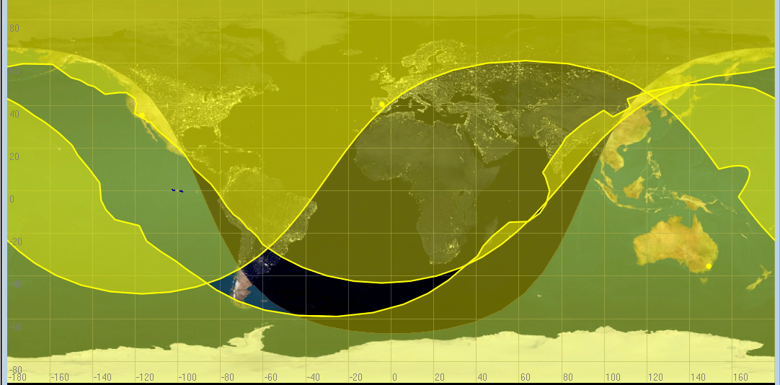
Largest Possible Time without DSN
Given:
  Closest distance to earth is 1,200,000 km
  Largest ‘gap’ in DSN coverage is 100 deg
  Earth rotates at 15 deg/hour
Maximum coverage gap approximately 6 hours
Given JWST allowed geometry estimated gap about half that

Slide 27
Conclusion

Slide 28
When is ‘Simple’ is not good enough?
Possible objections:
  Inherently non-linear or chaotic systems
  Complex fields & wave phenomena
  Stochastic systems, cellular automata, self-organized criticality
Response
  Simple doesn’t mean simplistic
  Analytic & Semi-Analytic principles are still needed
    Guide numerical exploration
    Build confidence in the numerical methods
    Provide ‘proof’ of the complexity by giving a baseline
  Combination of analytic, semi-analytic and numerical is best toolbox

Slide 29
Terminal Quotation
If you only have a hammer, you tend to see every problem as a nail. Abraham Maslow

